Slide 1
Commercial Computers
1947 - Eckert-Mauchly Computer Corporation
UNIVAC I (Universal Automatic Computer)
US Bureau of Census 1950 calculations
Became part of Sperry-Rand Corporation
Late 1950s - UNIVAC II
Faster
More memory
Notes:
<number>

Slide 2
IBM
Punched-card processing equipment
1953 - the 701
IBM’s first stored program computer
Scientific calculations
1955 - the 702
Business applications
Lead to 700/7000 series
Notes:
<number>

Slide 3
Second generation computers Introduction of Transistors
Replaced vacuum tubes
Smaller
Cheaper
Less heat dissipation
Solid State device
Made from Silicon (Sand)
Invented 1947 at Bell Labs
William Shockley et al.
Notes:
<number>

Slide 4
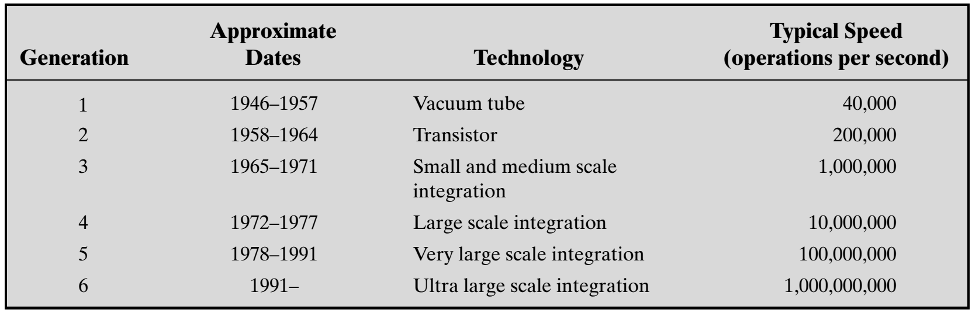
Generations of Computer
Notes:
<number>

Slide 5
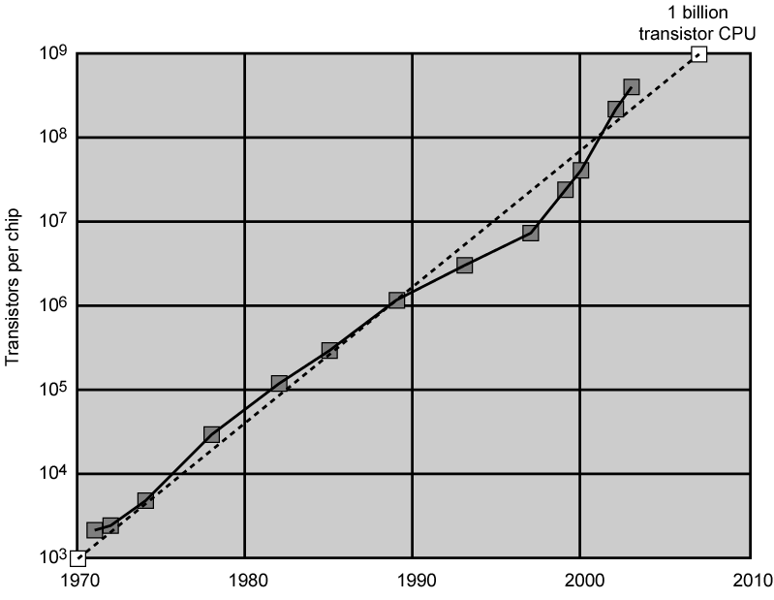
Moore’s Law
Increased density of components on chip
Gordon Moore – co-founder of Intel
Number of transistors on a chip will double every year
Since 1970’s development has slowed a little
Number of transistors doubles every 18 months
Growth in CPU Transistor Count
Notes:
<number>

Slide 6
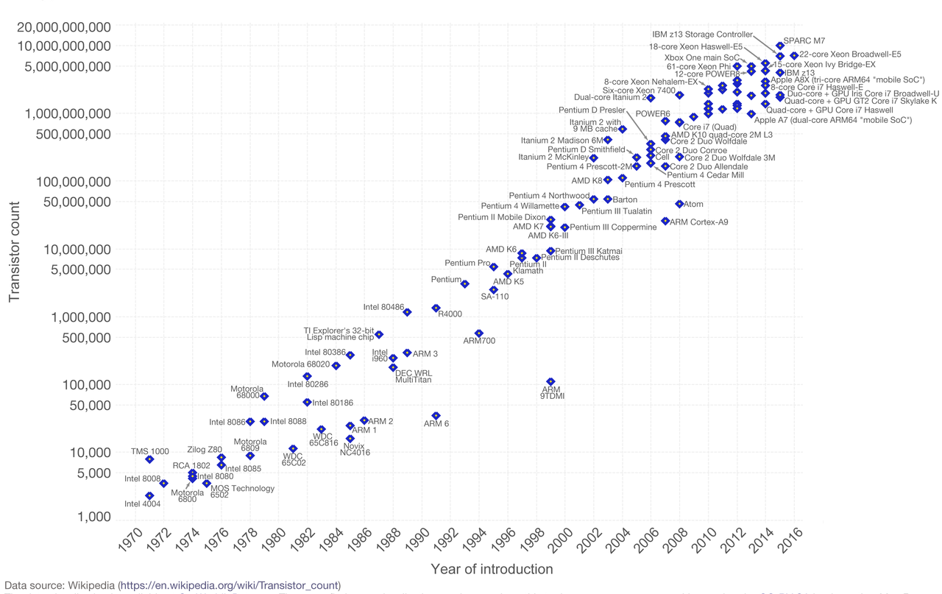

Slide 7
IBM 360 series
1964
Replaced (& not compatible with) 7000 series
First planned “family” of computers
Similar or identical instruction sets
Similar or identical O/S
Increasing speed
Increasing number of I/O ports (i.e. more terminals)
Increased memory size
Increased cost
Multiplexed switch structure
Notes:
<number>

Slide 8
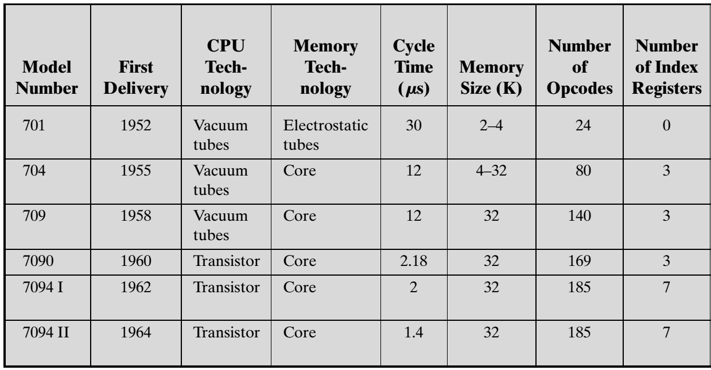

Slide 9
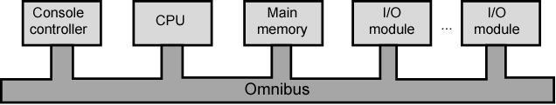
DEC PDP-8
The second generation is noteworthy also for the appearance of the Digital Equipment Corporation (DEC)>>>>COMPAQ>>>>HP.
DEC was founded in 1957 and when it delivered its first computer, the PDP-1 (Programmed Data Processor-1).
In 1964 First minicomputer named as DEC PDP-8
Did not need air conditioned room
Small enough to sit on a lab bench
$16,000
BUS STRUCTURE
Notes:
<number>

Slide 10
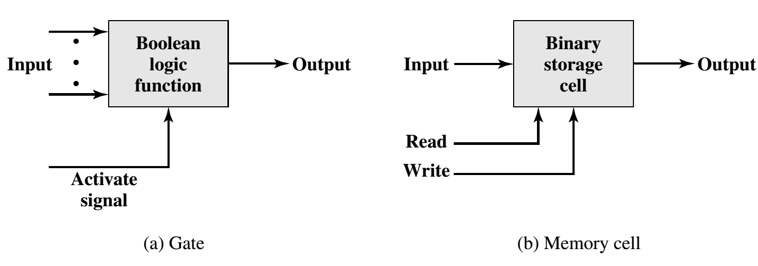
Third generation Introduction to Microelectronics and Semiconductor Memory
Microelectronics? Literally - “small electronics”
A computer is made up of gates, memory cells and interconnections
These can be manufactured on a semiconductor, e.g. silicon wafer
Basic function in a digital computer
GATES for processing
Memory cells for storage
Interconnection and control elements
for data movement and control signals
And the consequences of integration of the above elements in a single wafer is described in next slide.
Notes:
<number>

Slide 11
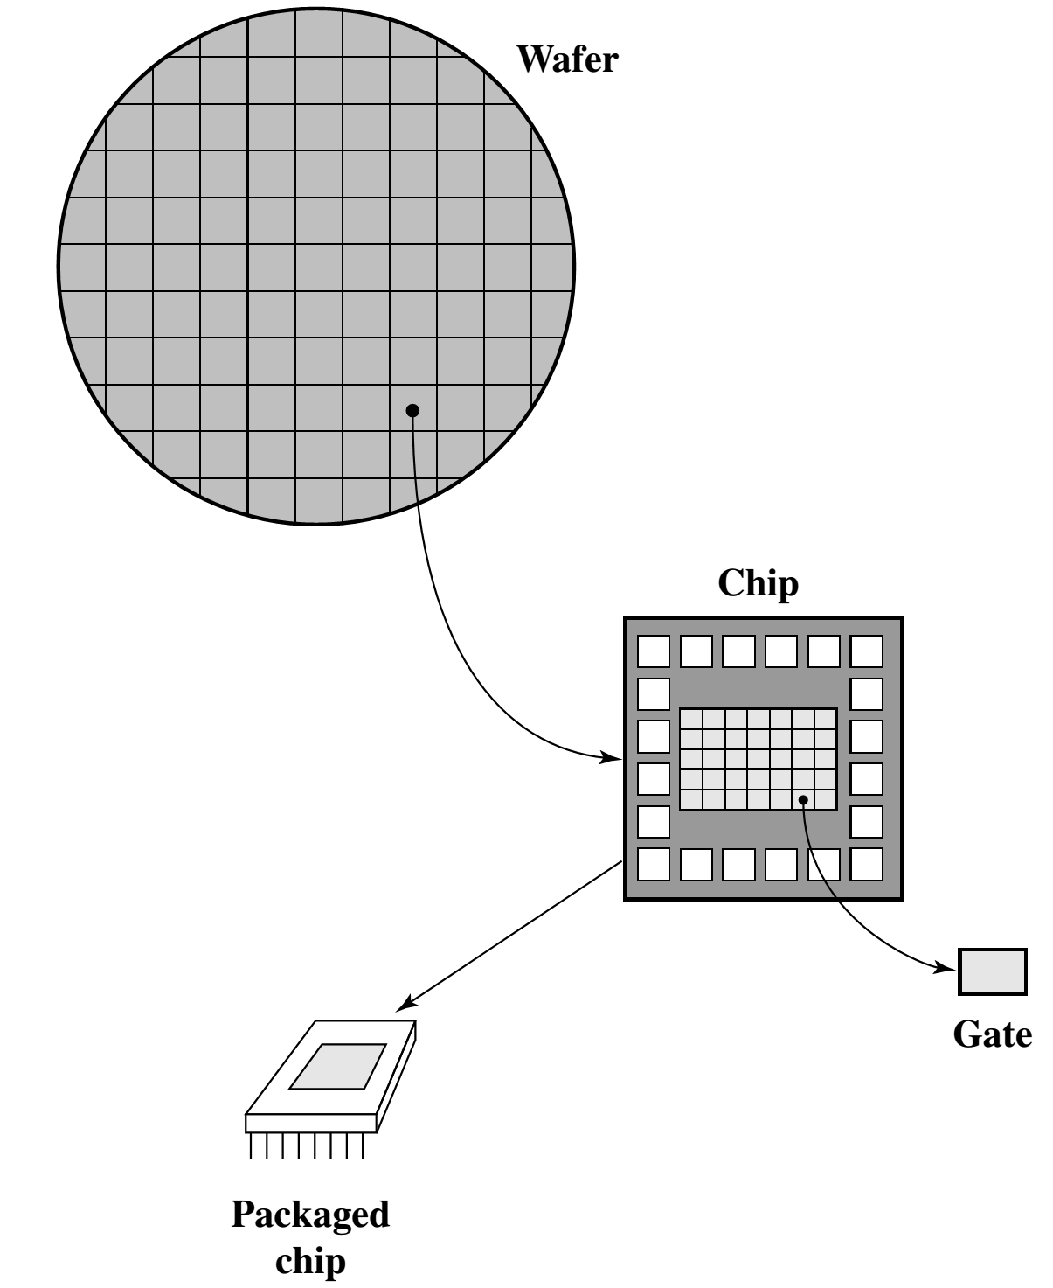
Relationship among Wafer, Chip and Gate
Cost of a chip has remained almost unchanged
Higher packing density means shorter electrical paths, giving higher performance
Smaller size gives increased flexibility
Reduced power and cooling requirements
Fewer interconnections increases reliability

Slide 12
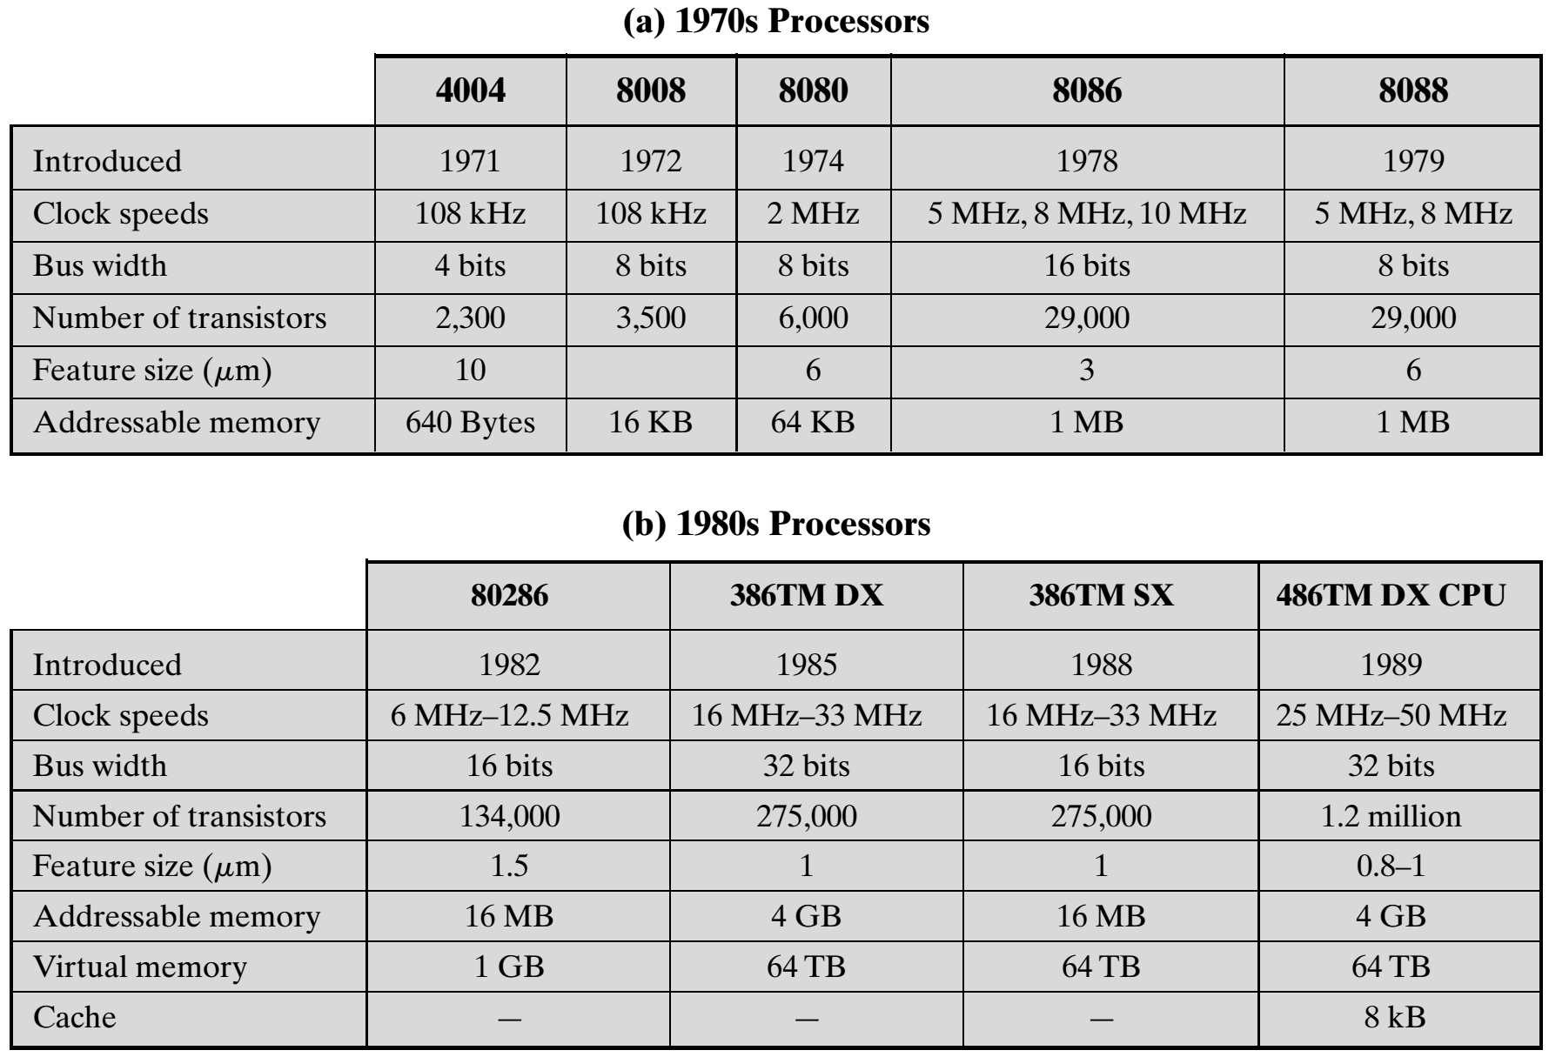
Evolution of Intel Microprocessors
Notes:
<number>

Slide 13
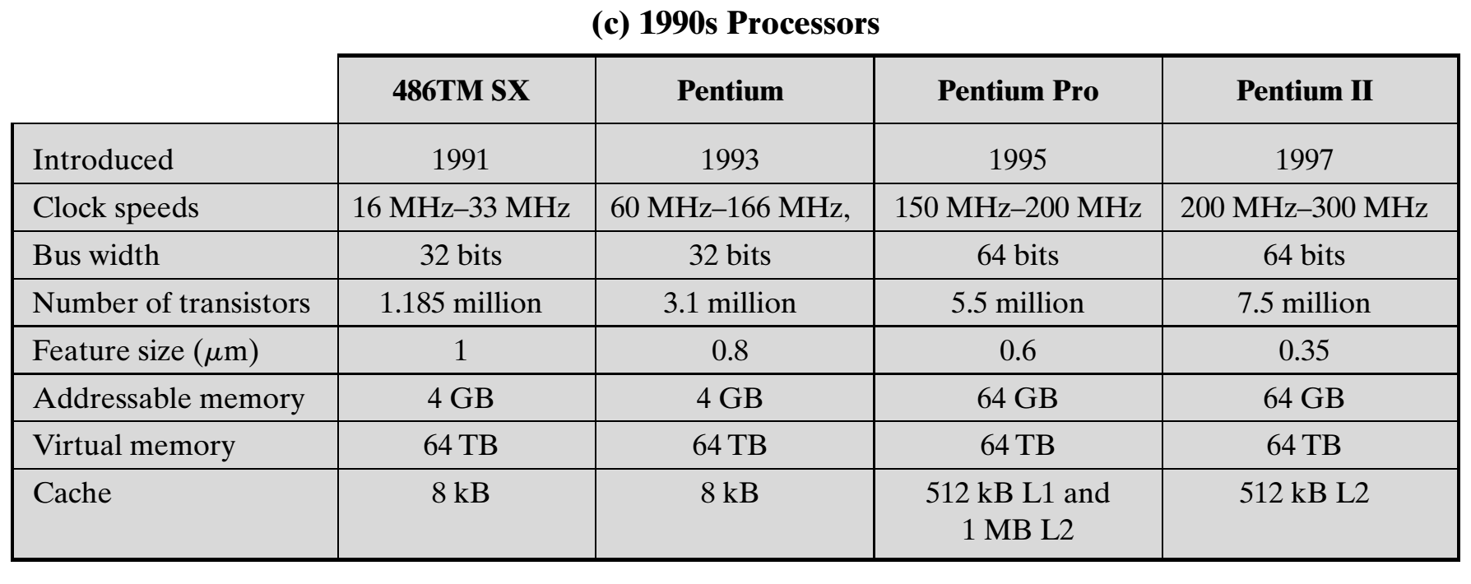
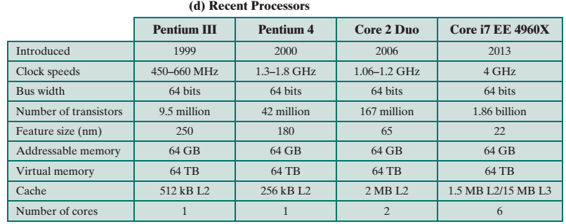

Slide 14
Speeding it up
Pipelining
On board cache
On board L1 & L2 cache
Branch prediction
Data flow analysis
Notes:
<number>

Slide 15
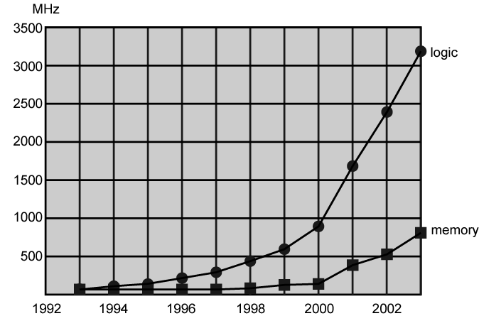
Performance Balance
Processor speed increased
Memory capacity increased
Memory speed lags behind processor speed
Logic and Memory Performance Gap
Notes:
<number>

Slide 16
Solutions
Increase number of bits retrieved at one time
Make DRAM “wider” rather than “deeper”
Change DRAM interface
Cache
Reduce frequency of memory access
More complex cache and cache on chip
Increase interconnection bandwidth
High speed buses
Hierarchy of buses
Notes:
<number>

Slide 17
I/O Devices
Peripherals with intensive I/O demands
Large data throughput demands
Processors can handle this
Solutions:
Caching
Higher-speed interconnection buses
More elaborate bus structures
Multiple-processor configurations

Slide 18
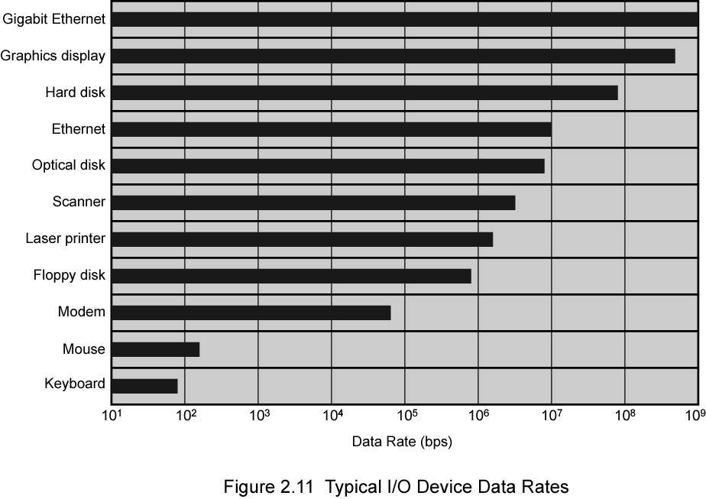
Typical I/O Device Data Rates

Slide 19
Key is Balance
Processor components
Main memory
I/O devices
Interconnection structures

Slide 20
Improvements in Chip Organization and Architecture
Increase hardware speed of processor
Fundamentally due to shrinking logic gate size
More gates, packed more tightly, increasing clock rate
Propagation time for signals reduced
Increase size and speed of caches
Dedicating part of processor chip
Cache access times drop significantly
Change processor organization and architecture
Increase effective speed of execution
Parallelism

Slide 21
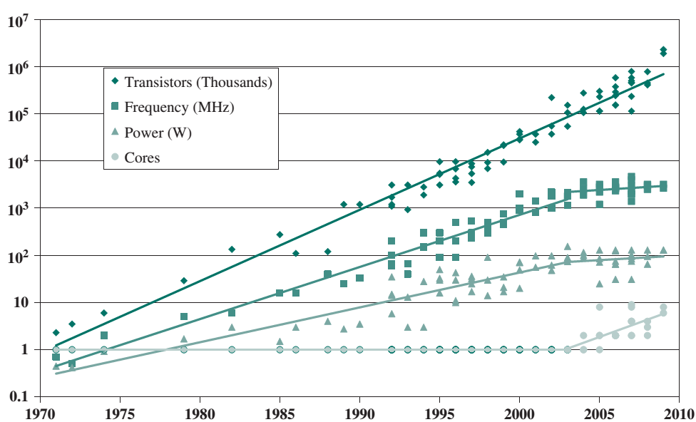
Processor Trend

Slide 22
Problems with Clock Speed and Logic Density
Power
Power density increases with density of logic and clock speed
Dissipating heat
RC delay
Speed at which electrons flow limited by resistance and capacitance of metal wires connecting them
Delay increases as RC product increases
Wire interconnects thinner, increasing resistance
Wires closer together, increasing capacitance
Memory latency
Memory speeds lag processor speeds
Solution:
More emphasis on organizational and architectural

Slide 23
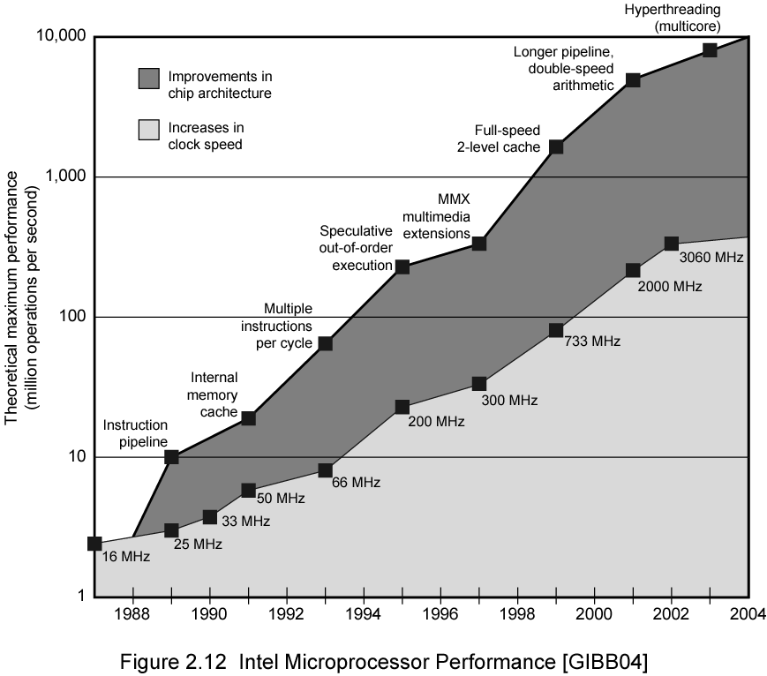
Intel Microprocessor Performance

Slide 24
Increased Cache Capacity
Typically two or three levels of cache between processor and main memory
Chip density increased
More cache memory on chip
Faster cache access
Pentium chip devoted about 10% of chip area to cache

Slide 25
More Complex Execution Logic
Enable parallel execution of instructions
Pipeline works like assembly line
Different stages of execution of different instructions at same time along pipeline
Superscalar allows multiple pipelines within single processor
Instructions that do not depend on one another can be executed in parallel

Slide 26
Diminishing Returns
Increasing clock rate runs into power dissipation problem
Some fundamental physical limits are being reached
Internal organization of processors complex
Can get a great deal of parallelism
Further significant increases likely to be relatively modest
Benefits from cache are reaching limit

Slide 27
New Approach – Multiple Cores
Multiple processors on single chip
Large shared cache
Within a processor, increase in performance proportional to square root of increase in complexity
If software can use multiple processors, doubling number of processors almost doubles performance
So, use two simpler processors on the chip rather than one more complex processor
With two processors, larger caches are justified

Slide 28
Performance Assessment
Performance is one of the key parameters to consider, along with cost, size, security, reliability, and, in some cases power consumption.
Application performance depends not just on the raw speed of the processor, but on the instruction set, choice of implementation language, efficiency of the compiler, and skill of the programming.
Clock Speed
The System Clock: The most fundamental level, the speed of a processor is dictated by the pulse frequency produced by the clock, measured in cycles per second, or Hertz (Hz).
Clock signals are generated by a quartz crystal
The rate of pulses is known as the clock rate, or clock speed
One increment, or pulse, of the clock is referred to as a clock cycle, or a clock tick.
The time between pulses is the cycle time.
For example, a 1-GHz processor receives 1 billion pulses per second.
Notes:
<number>

Slide 29
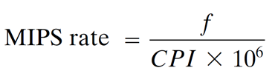
Performance Assessment
Millions of instructions per second (MIPS) or MIPS rate
The System Clock: The most fundamental level, the speed of a processor is dictated by the pulse frequency produced by the clock, measured in cycles per second, or Hertz (Hz).
CPI: Cycle per instruction
f: Clock frequency (number of cycle per second)
Example: Consider a program has 2 Millions (2x10⁶ instructions) is running on a 400 MHz processor. The program consists of three major types of instructions, ALU related, load/store, and branching. These instruction requires 1, 2, and 4 CPI with a instruction mix of 60, 30, and 10% respectively in the program. Estimate the MIPS of the processor.
Solution: CPI=0.6x1+0.3x2+0.1x4=1.6
MIPS=(400x10⁶)/(1.6x10⁶)=250 MIPS
Notes:
<number>

Slide 30
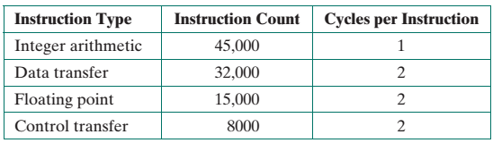
Homework:
A benchmark program is run on a 40 MHz processor. The executed program consists of 100,000 instruction executions, with the following instruction mix and clock cycle count. Estimate the CPI, MIPS and execution time of the program.

